Slide 1
Stock portfolio tracker

Slide 2
Overview:
The Stock Portfolio Tracker is a simple yet powerful Python-based project designed to help users monitor and manage their stock investments efficiently. This tool allows users to define their stock holdings manually and calculates the total investment based on custom input prices.
With a focus on simplicity and clarity, this tracker enables users to:
Keep track of multiple stock symbols and quantities.
Input current or manually-set stock prices.
Instantly compute the total value of their portfolio.
Understand individual stock contributions to the overall investment.
Unlike real-time market trackers, this system is intended for learning and personal finance management, offering a lightweight alternative without relying on APIs or live data.
The project is a foundational step towards developing more complex financial applications and introduces users to key concepts like data structures, loops, functions, and modular code design in Python.

Slide 3
System architecture:
The Stock Portfolio Tracker follows a modular and layered architecture, ensuring clarity, maintainability, and scalability of the code. The system is divided into the following key components:
1.INPUT LAYER:
Purpose: Collects user-defined data about stock symbols, quantities owned, and stock prices.
Method: Manual input through code variables or optional user prompts (e.g., via input()).
2.PROCESSING LAYER:
Purpose: Performs core logic operations on the input data.
Responsibilities : Validates input types (e.g., strings for stock names, integers/floats for quantity and price).
Calculates total investment per stock (price × quantity).
Computes overall portfolio value .Formats data for output.

Slide 4
3. DATA STRUCTURE:
Stock Data Storage: Utilizes dictionaries to store and associate stock symbols with their respective quantities and prices.
portfolio = { 'AAPL': {'quantity': 10, 'price': 180.0}, 'GOOGL': {'quantity': 5, 'price': 2750.0},}
4.OUTPUT LAYER:
Purpose: Displays results in a clear, readable format.
Features: Shows individual stock details (name, quantity, price, total value).
Shows final portfolio value.
Optionally formats output as a table for readability.

Slide 5



CORE LOGIC IMPLEMENTATION :
CALCULATE INDIVIDUAL AND TOTAL PORTOFOLIO VALUE
INPUT DATA STRUCTURE
DISPLAY RESULTS

Slide 6
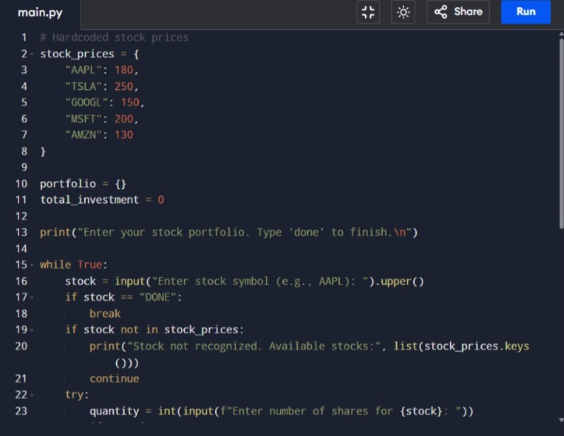

Slide 7
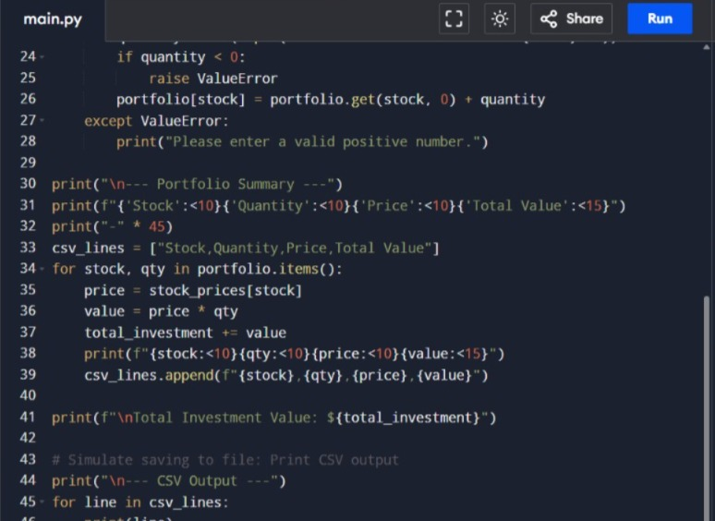

Slide 8
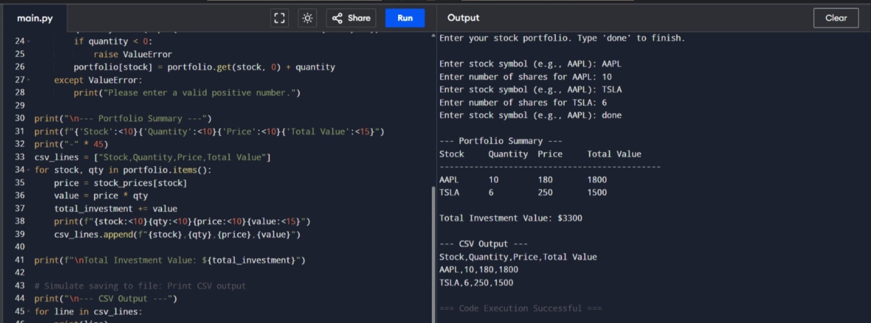

Slide 9
Integration testing:
Stock Data Fetcher
Portfolio Manager
User Interface
Database/
Storage Module
Profit/Loss
Calculator

Slide 10
CODE STRUCTURE AND DESIGN PATTERNS:
MVC /
Command:
UI Interaction
Service Layer:
Seperation of logic
Data class:
Structuring stock and portfolio data

Slide 11

Project Summary
Key Achievements:
Summarizing the key achievements
Of the stock portfolio tracker.
Successfully implemented a
Stock value tracker . Demonstrated
Proficiency in Python .
Lessons Learned:
Learned about design patterns , code reuse , and real world logic.
Realize the importance of proper error handling and version control.

Slide 12
THANK YOU.

